Slide 1
Storing Data
Lecture- 7
Tokey Ahmmed
Lecturer, Dept. of CSE
Varendra University

Slide 2
The purpose of a storage device
is to hold data—even when the computer is turned off—so the data can be used whenever it is needed.
Storage involves two processes:
Writing, or recording, the data so it can be found later for use.
Reading the stored data, then transferring it into the computer' s memory.

Slide 3
Storage Media and Storage Devices
The physical materials on which data is stored arc called storage media.
The hardware components that write data to, and read data from, storage media are called storage devices.

Slide 4
Categorizing Storage Devices
Magnetic storage
Optical storage
Solid State Storage

Slide 5
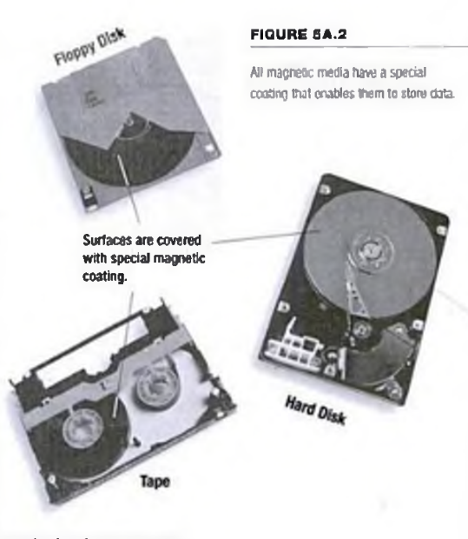
Magnetic Storage Devices
diskette drives
hard disk drives
high-capacity floppy disk drives and
tape drives
The surfaces are coated with a magnetically sensitive material, such as iron oxide, that reacts to a magnetic field

Slide 6
How Data Is Stored on a Disk
Making magnet
Stroking with a magnet.
Using electrical current
just as a transistor can represent binary data as “ on" or “off,” the orientation of a magnetic field can be used to represent data.
A magnet has one important advantage over a transistor: that is, it can represent “ on” and “ o ff without a continual source of electricity.

Slide 7
The surfaces of magnetic disks and tapes are coated with millions of tiny iron particles so that data can be stored on them.
Each of these particles can act as a magnet, taking on a magnetic field when subjected to an electromagnet.

Slide 8
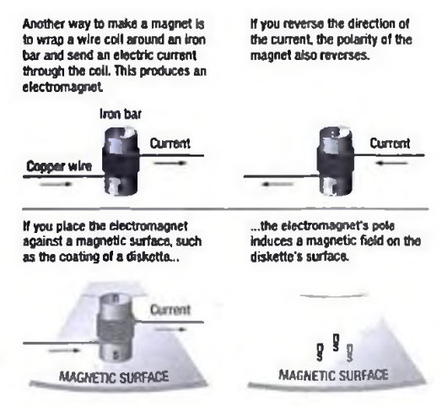

Slide 9
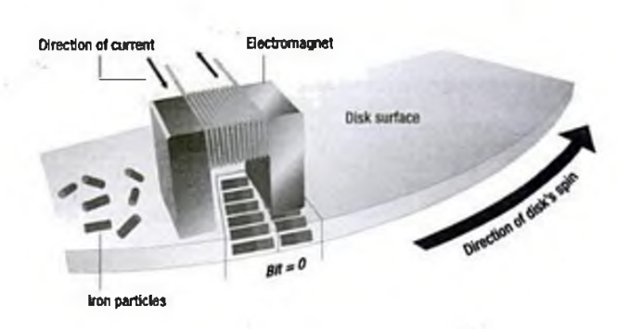
Data Write
The read/write heads of a magnetic disk or tape drive contain electromagnets that generate magnetic fields in the iron on the storage medium as the head passes over the disk or tape.
As shown in Figure 5A.4, the read/write heads record strings of 1s and 0s by alternating the direction of the current in the electromagnets.

Slide 10
Data Read
To read data from a magnetic surface, the process is reversed.
The read/write head passes over the disk or tape while no current is flowing through the electromagnet.
The head possesses no charge, but the storage medium is covered with magnetic fields, which represent bits of data.
The storage medium charges the magnet in the head, which causes a small current to flow through the head in one direction or the other; depending on the field's polarity.

Slide 11
The disk or tape drive senses the direction of the flow as the storage medium pastes by the head, and
the data is sent from the read/write head into memory.

Slide 12
How Data is Organized on a Magnetic Disk
the disk’s surface must be magnetically mapped
so that the computer can go directly to a specific point on it without searching through data.
the process of mapping a disk is called formatting or initializing.

Slide 13
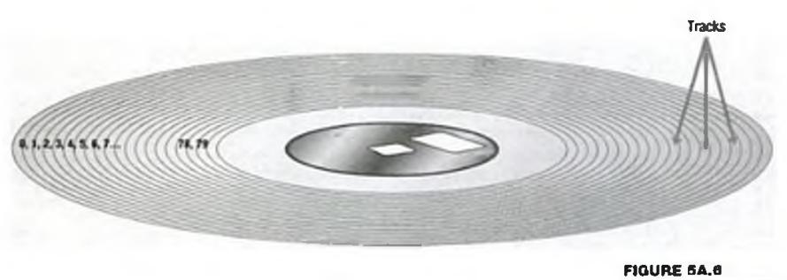
Tracks and Sectors
When you format a magnetic disk, the disk drive creates a set of concentric rings, called tracks, on each side of the disk.
The tracks are numbered from the outermost circle to the innermost, starting with 0

Slide 14
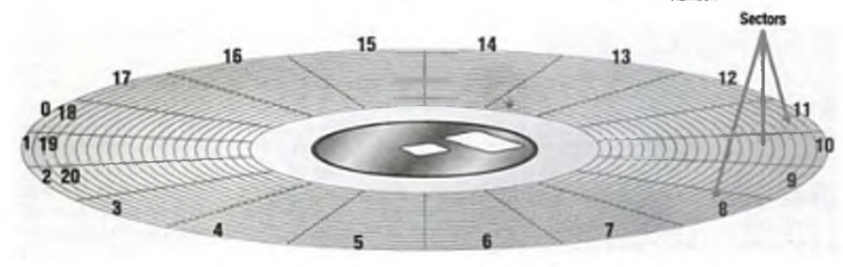
Tracks and Sectors
In the next stage of formatting, the tracks are divided into smaller parts.
resulting in short segment s called sectors.

Slide 15
Tracks and Sectors
Sectors are where data is physically stored on the disk.
All the sectors on a disk are numbered in one long sequence, so that the computer can access each small area on the disk by using a unique number.
A sector is the smallest unit with which any magnetic disk drive can work;
the drive can read or write only whole sectors at a time.
If the computer needs to change just one byte out of 512, it must rewrite the entire sector.

Slide 16
How the Operating System Finds Data on a Disk
A computer’s operating system can locate data on a disk because-
logical formatting- The labeling of tracks and sectors
special log on the disk
Different operating systems can format disks in different ways.
A commonly used logical format performed by Windows is called the FAT file system
relies on a standardized file allocation table (FAT) to keep track of file locations on the disk.

Slide 17
How the Operating System Finds Data on a Disk
When a diskette is formatted with the FAT file system, four areas are created on the disk
The boot sector
The file allocation table (FAT)
The root folder
The data area

Slide 18
The boot sector
contains a program that runs when you first start the computer.
This program determines whether the disk has the basic components that arc necessary to run the operating system successfully.
If the program determines that the required files are present and the disk has a valid format, it transfers control to one of the operating system programs that continues the process of starting up.

Slide 19
The boot sector
This process is called booting, because the boot program makes the computer “ pull itself up by its own bootstraps.”
The boot sector also contains information that describes other disk characteristics such as
the number of bytes per sector and
the number of sectors per track-
information that the operating system needs to access data on the disk.

Slide 20
The file allocation table (FAT)
is a log that records the location of each file and the status of each sector.
When you write a file to a disk, the operating system checks the FAT to find an open area, stores the file, and then logs the file’s identity and its location in the FAT.
When a program needs to locate data on the disk, the operating system checks the FAT to see where that data is stored.

Slide 21
The root folder
is the “ master folder" on any disk. A folder (also called a directory) is a tool for organizing files on a disk.
Folders can contain files or other folders, so it is possible to set up a hierarchical system of folders on your computer, just as you can have folders within other folders in a file cabinet.
The topmost folder is known as the root, but may also be called the root folder or root directory.
This is the folder that holds all the information about all the other folders on the disk.

Slide 22
The data area
is the part of the disk that remains free after the boot sector, the FAT, and the root folder have been created.
This is where data and program files are actually stored on the disk.

Slide 23
Clusters
During logical formatting, the operating system also groups sectors together, into storage units called clusters.
A cluster is simply a group of sectors that the OS se e s as a single unit.
A cluster is the smallest space an OS w ill allocate to a single file, and a cluster may store an entire file or just part of a file.
Cluster sizes vary, depending on the size and type of the disk, but they can range from four sectors for diskettes to 64 sectors for some hard disks.
Cluster usage is tracked in the file allocation table.

Slide 24
Different File Systems
File Allocation Table (FAT).
FAT32.
New Technology File System (N TFS).
NTFS 5.
High-Performance File System (HPFS).
Other operating systems (such as U N IX), and even some network operating systems (such as Novell NetWare), use their own file systems.

Slide 25
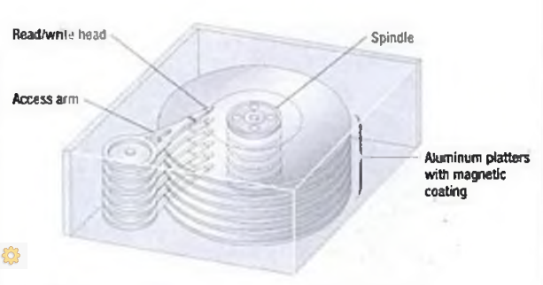
Hard Disks
A hard disk includes one or more platters mounted on a central spindle
Each platter is covered with a magnetic coating, and the entire unit is encased in a sealed chamber.
The hard disk and drive are a single unit.
It includes the hard disk, the motor that spins the platters, and a set of read/write heads.
Because you cannot remove the disk from its drive (unless it is a removable hard disk) the terms hard disk is used.

Slide 26
Optical Storage Devices
store data on a reflective surface so it can be read by a beam of laser light.
A laser uses a concentrated, narrow beam of light, focused and directed with lenses, prisms, and mirrors.
CD-ROM,
DVD-ROM, and
their variants.

Slide 27
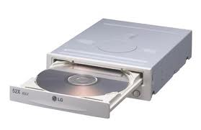
CD-ROM
Compact Disc-Read-Only Memory (CD -ROM )
same technology used to produce music CDs.
A CD-ROM drive reads digital data (whether computer data or audio) from a spinning disc by focusing a laser on the disc’s surface.
Storage capacity

Slide 28
Data is laid out on a CD-ROM disc in a long, continuous spiral.
Data is stored in the form of lands, which are flat areas on the metal surface, and pits, which are depressions or hollows.
a land reflects the laser light into the sensor (indicating a data bit of 1) and
a pit scatters the light (indicating a data bit of 0).

Slide 29
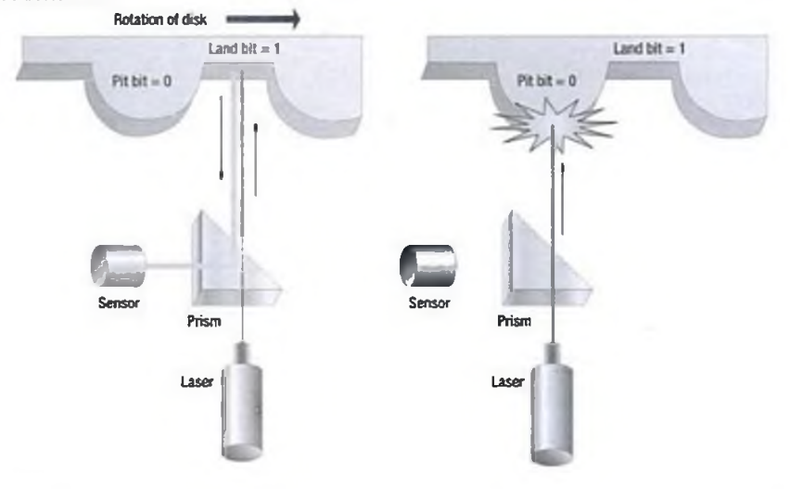

Slide 30
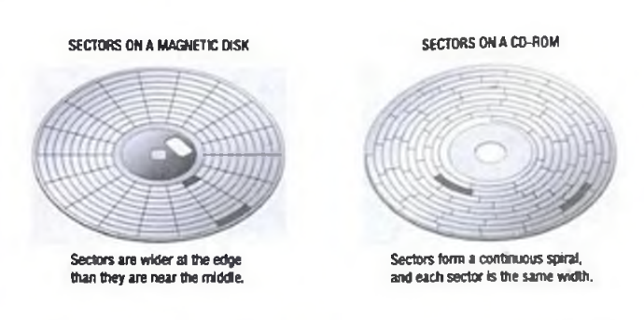
Compared to hard disk drives, CD-ROM drives are slow.
has to change rotational speed of the disk.
Speed (150 KBps)

Slide 31
DVD-ROM
Digital Video Disc- Read-Only Memory (DVD-ROM)
Size 4.7 to 17 GB.
DVD-ROM achieves high storage capacities by using
both sides of the disc
special data-compression technologies and
extremely small tracks for storing data.
layers of data tracks, effectively doubling their capacity.

Slide 32
Solid-State Storage Devices
Unique among today’s storage devices because they
do not use disks or tapes and have
no moving parts.
neither magnetic nor optical.
Instead, it relies on integrated circuits to hold data.
volatile or non-volatile – depends on memory circuits it uses.

Slide 33
Comparing
Byte for byte, standard magnetic or optical storage is less expensive and more reliable than solid-state storage.
High Speedy:
have no moving parts
because they already store data electronically
do not need to move a head or sensor to find data
do not need to convert it from magnetic or optical form into electronic form.

Slide 34
Smart Cards
a smart cord is a device wit extraordinary potential.
Smart cards contain a small chip that stores data.
Using a special device, called a smart card reader; the user can read data from the card, add new data, or revise existing data.

Slide 35
Solid State Disks
A solid-state disk (SSD ) is not a disk at all. Rather, this device uses very last memory chips, such as synchronous dynamic RAM (SD RA M ), to store data.
SDRAM is much faster than standard RAM
Large-scale SSD systems can store a terabyte or more of data.
SSDs are gaining popularity among large organizations, which need instant access to constantly changing data.
The biggest drawback of RAM-based SSDs (aside from their high cost) is volatility.

Slide 36
The End

